Slide 1
Data Structures & Algorithms (CSC-214)
Linked List

Slide 2
Arrays as an ADT
Pros
Simple
Useful for storing items in a certain order
Cons
Not very easily adaptable
The size n has to be fixed in advance, due to which resizing is also inconvenient
Insertion and deletion is problematic because values need to be shifted around -> consecutive memory

Slide 3
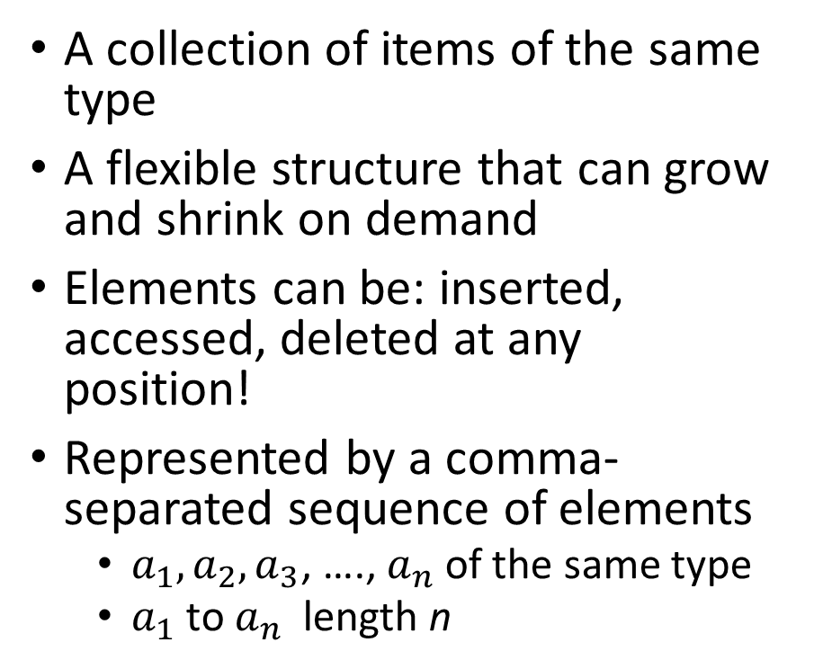
List as an ADT
A collection of items of the same type
A flexible structure that can grow and shrink on demand
Elements can be: inserted, accessed, deleted at any position!
Represented by a comma-separated sequence of elements
$a_{1}, a_{2}, a_{3}$, …., $a_{n}$of the same type
$a_{1}$ to $a_{n}$ length n
Can have a single element
Can have no elements
Can be list of lists
Can be concatenated together
Can be split into sub-lists

Slide 4
Examples of Everyday List
Everyday usage of the term “list” refers to a linear collection of data items
Groceries to be purchased
Ingredients of a recipe
Jobs to-do list
List of assignments for a course
List of courses for a semester
Can you name some others??

Slide 5
List as a Data Structure
Implementation: data members and functions
There are two possible implementation approaches
Array-based Implementation of lists
Pointers-based implementation of lists

Slide 6
List as a Data Structure - functions
Create the list. The list is initialized to an empty state
Determine whether the list is empty/full
Find the size of the list
Destroy, or clear, the list
Insert an item in the list at the specified location
Delete an item from the list at the specified location
Replace an item at the specified location with another item
Retrieve an item from the list at the specified location
Search the list for a given item
Traverse (iterate through) the elements of the list

Slide 7
List as a Data Structure - functions
INSERT(x, p, L): Insert x at position p in list L. If list L has no position p, the result is undefined
RETRIEVE(p, L): Return the element at position p on list L
LOCATE(x, L): Return the position of x on list L
DELETE(p, L): Delete the element at position p on list L
MAKENULL(L): Causes L to become an empty list and returns position END(L)
NEXT(p, L): Return the position following p on list L
PREVIOUS(p, L): Return the position preceding position p on list L
FIRST(L): Returns the first position on the list L
PRINTLIST(L): Print the elements of L in order of occurrence

Slide 8
Array-Based Implementation of Lists

Slide 9
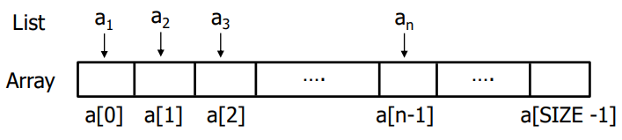
Array-Based Implementation
An array is a viable choice for storing list elements
Elements are sequential
Array is a commonly available data type
Algorithm development is easy
Normally sequential orderings of list elements match with array indices

Slide 10
Array-Based Implementation
Create a List class, containing at least the following function members
Constructor
isEmpty()
insert()
delete()
print()
What are the other function members?
isFull(), listSize(), retrieve(), replace(), search(), clearList( ), …
Recap:
Constructor
Static array allocated at compile time
isEmpty
Check if size == 0
Insert
Shift elements to right of insertion point
Delete
Shift elements back
traverse/print
Use a loop from 0th element to size – 1

Slide 11
Array-Based Implementation
Insert(), erase() functions inefficient for dynamic lists
Frequent changes
Many insertions and deletions
We look for an alternative implementation

Slide 12
An Alternative Implementation

Slide 13
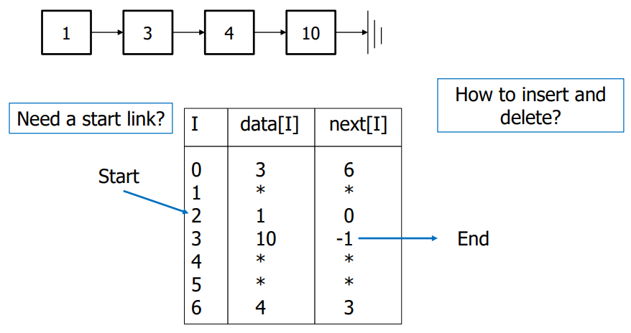
An Alternative Implementation

Slide 14
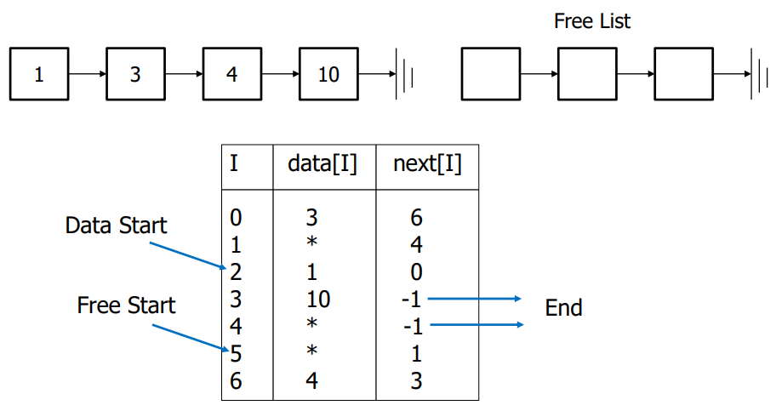
Yet Another Implementation – Free List (1)

Slide 15
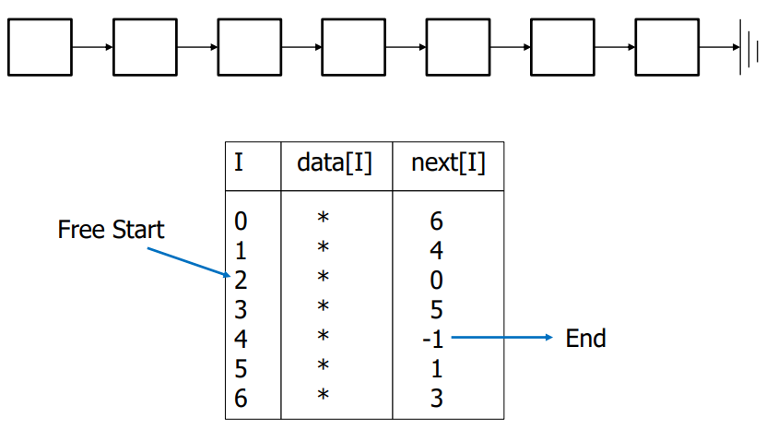
Yet Another Implementation – Free List (2)

Slide 16
List Class with Static Arrays - Problems
Stuck with "one size fits all“
Could be wasting space
Could run out of space
Better to have instantiation of a list by specifying the capacity (i.e., size) -> don’t hard code the size
Consider creating a List class with dynamically-allocated array

Slide 17
Dynamic Allocation of List Class (1)
Changes required in data members
Eliminate constant declaration for CAPACITY/SIZE
Data member to store capacity specified by client program
Little or no changes required for many function members
isEmpty(
display()
erase()
insert()

Slide 18
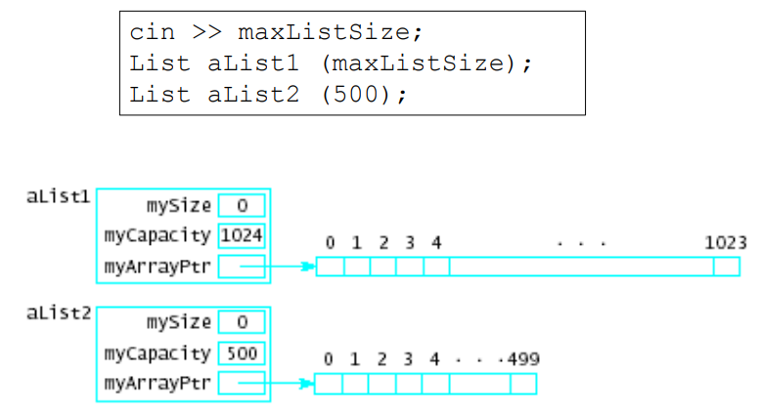
Dynamic Allocation of List Class (1)
Now possible to specify different sized lists

Slide 19
Problems with Array based implementation
Problem 1: Array used has fixed capacity
If larger array needed during program execution
Allocate, copy smaller array to the new one
Problem 2: Class bound to one type at a time
Create multiple List classes with differing names
Use class template (will discuss in Lab portion)

Slide 20
Any Questions?

